Slide 1

Computer Science and the Future
Akash Singh and Émilie Mayodon

Slide 2

Introduction
The future, employment, and salaries
Business and company needs
Impact on our everyday lives
Ethical dilemma on privacy

Slide 3
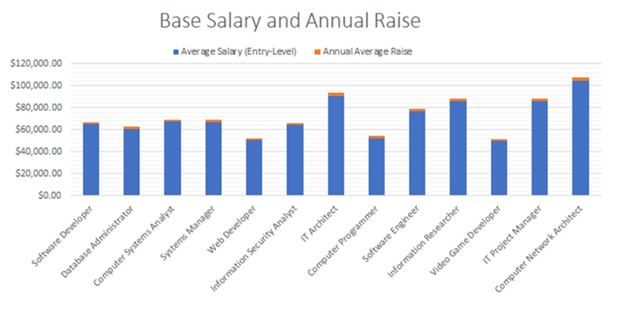
Careers and salaries
Jobs | Average Salary (Entry-Level) | Annual Average Raise
Software Developer | $65,000.00 | $1,690.00
Database Administrator | $61,000.00 | $1,586.00
Computer Systems Analyst | $67,460.00 | $1,753.96
Systems Manager | $67,000.00 | $1,742.00
Web Developer | $51,000.00 | $1,326.00
Information Security Analyst | $64,600.00 | $1,679.60
IT Architect | $91,000.00 | $2,938.00
Computer Programmer | $52,000.00 | $2,531.10
Software Engineer | $77,000.00 | $2,002.00
Information Researcher | $86,000.00 | $2,236.00
Video Game Developer | $50,276.00 | $1,307.18
IT Project Manager | $86,126.00 | $2,239.28
Computer Network Architect | $104,650.00 | $2,720.90
Canadian Annual Interest Rate |  | 2.60% (2019)
The following diagram demonstrates the starting salary of common careers in the Computer Science Field, and its annual average raise
The current Canadian annual average salary increase is 2.60%, this leads to a greater pay growth. Jobs with a generally high demand tend to receive a bigger annual increase.
As shown, computer network architect has the highest paying job with the highest annual increase, while video game developer, statistically, is the lowest paying job and with the lowest salary raise.

Slide 4
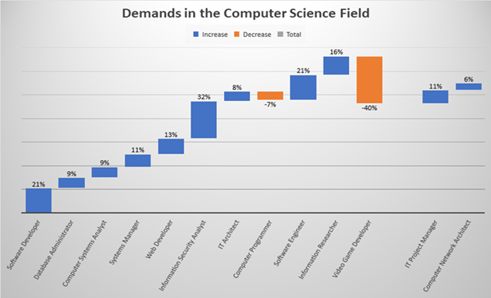
Degrees and Demands
Jobs | Degree Required | Demands
Software Developer | Bachelor's Degree | 21%
Database Administrator | Bachelor's Degree | 9%
Computer Systems Analyst | Bachelor's Degree | 9%
Systems Manager | Bachelor's Degree | 11%
Web Developer | Associate | 13%
Information Security Analyst | Bachelor's Degree | 32%
IT Architect | Bachelor's Degree | 8%
Computer Programmer | Bachelor's Degree | -7%
Software Engineer | Bachelor's Degree | 21%
Information Researcher | Master's Degree | 16%
Video Game Developer | Bachelor's Degree | -40%
IT Project Manager | Bachelor's Degree | 11%
Computer Network Architect | Bachelor's Degree | 6%
Most of the careers require a Bachelor’s Degree, while Information Researcher needs a Master’s Degree, and a Web Developer requires an Associate.
This waterfall chart shows the current percentage of demands for a list of common jobs in the Computer Science Field.
Unfortunately, video game developers are in high decrease of demands, while information security analyst is soaring in demands.

Slide 5
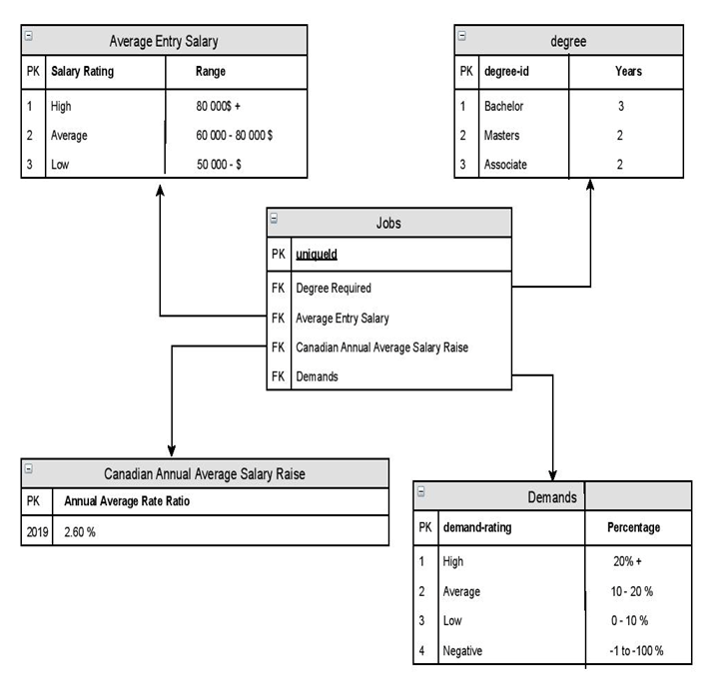
ER Diagram

Slide 6

Ethical Dilemma: Online Privacy
 | Gains | Losses
Public | Public recognition (fame) Express oneself Entertainment purposes Way to distract oneself from other problems | Intruding personal life Cyberbullying Leak of private information/photos Circulation of fakes news Trace everything back to you
Government | Stop online trafficking of photos Tracking potential criminals | Total surveillance of citizens (Big Brother, Edward Snowden) Loss of public trust

Slide 7
Ethical Dilemma: Online Privacy
Duties | Public | Government
Public | Report share of unwanted private information Don’t cyberbully Think twice before posting online Check the reliability of the sources | Report scams and cyber crimes
Government | Be honest about the surveillance system Provide a safe place | Filter what should be watched and registered

Slide 8

Conclusion
Different paths
Ethical topics

